Slide 1

Alveolar Bone
RUNGTA COLLEGE OF DENTAL SCIENCES & RESEARCH
DEPARTMENT OF ORAL PATHOLOGY

Slide 2
Specific learning Objectives
Core areas* | Domain ** | Category #
Introduction to bone | COGNITIVE | MUST KNOW
Structure of a bone Classification of bones Composition of bones | COGNITIVE COGNITIVE COGNITIVE | MUST KNOW MUST KNOW MUST KNOW
Bone remodelling Functions of bone Age changes in bone Remodelling of bone | COGNITIVE COGNITIVE COGNITIVE COGNITIVE | MUST KNOW MUST KNOW NICE TO KNOW DESIRED TO KNOW

Slide 3
OBJECTIVES
To know the various morphologic, anatomic and histologic and their application in clinical aspects relating to physiologic and pathologies alterations of bone

Slide 4
CONTENTS
Introduction to bone
Structure of a bone
Classification of bones
Composition of bones
Bone remodelling
Functions of bone
Age changes in bone

Slide 5
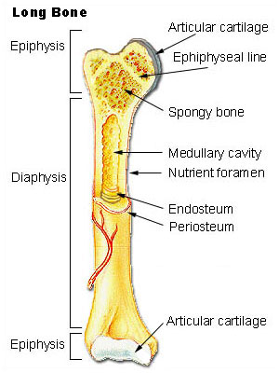
BONE
Introduction
Classification
Composition
Histology
Cells of bone
Formation of bone
Remodelling of bone
Alveolar bone
Age changes

Slide 6
Introduction to BONE
Living connective tissue
Makes up the body skeleton
One of the hardest structures of body
It possess toughness and elasticity
It provides shape and support for the body
It provides site of attachement for tendons and muscles, essential for locomotion
Hardness
Enamel > Dentin > Bone > Cementum

Slide 7
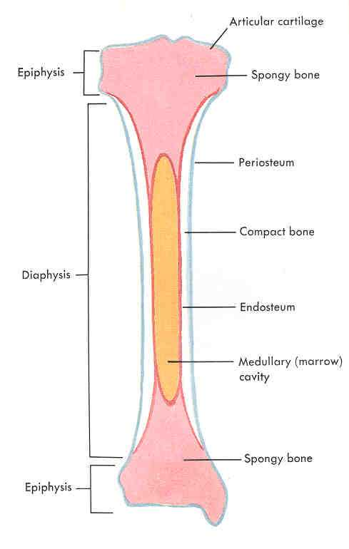
STRUCTURE OF A BONE
Diaphysis : centre piece, the shaft
Epiphysis : a thickened head at each end.
Periosteum : Covering of bone richly supplied with blood vessels.
Compact bone : Beneath the periosteum
Marrow cavity : a hollow cavity lined with endosteum.
The marrow cavity contains a soft tissue richly supplied with fat cells and blood corpuscles, the yellow marrow.
Endosteum : Covering of bone marrow cavity

Slide 8
Classification Of Bones
Classified according to their :
1] SHAPE
Long, Short, Flat, Irregular, Sessamoid
2] MODE OF DEVELOPMENT
Endochrondal, Intramembranous
3] HISTOLOGIC APPEARANCE
Mature (compact, cancellous)
Immature (Woven)

Slide 9
3] CLASSIFICATION BASED ON THEIR HISTOLOGIC APPEARANCE
1] MATURE BONE
2] IMMATURE BONE / Woven Bone
2 kinds of MATURE BONE
Compact bone (dense bone / cortical bone/ lamellar bone)
hard outer layer
responsible for stability of skeleton
Spongy bone (cancellous bone / trabecular bone / medullary bone)
harbours bone marrow
accounts for elasticity

Slide 10
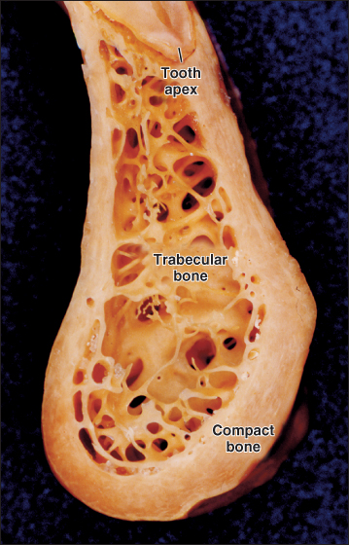
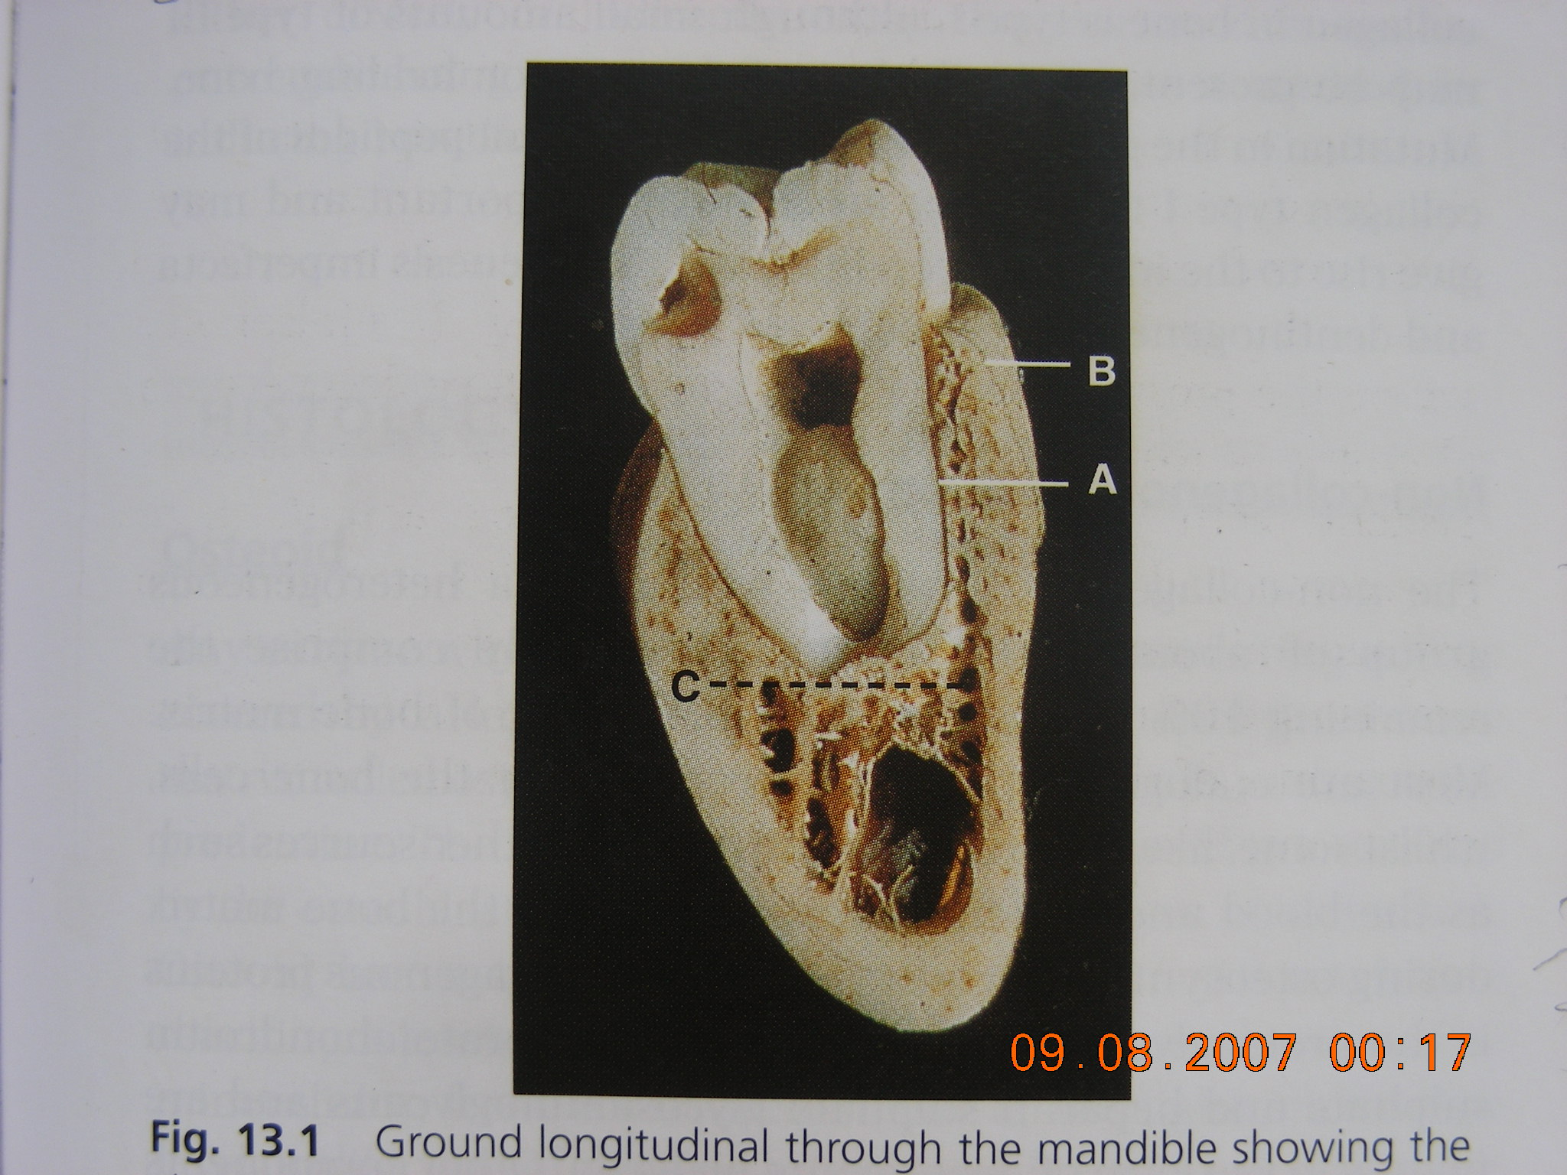

Slide 11
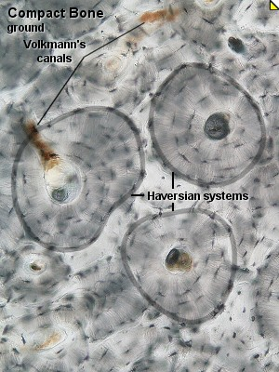
Compact Bone (Histology)
Tightly packed
Consist of osteons
(Haversian system)
Solid mass
Arranged in layers (Lamellae)
Osteon = Haversian canal
+
Concentic lamellae

Slide 12
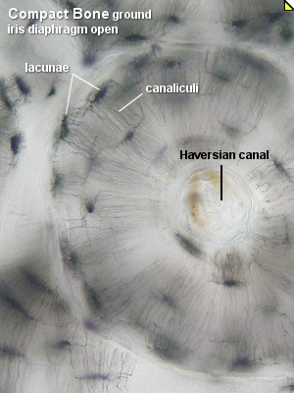
Compact bone - Histology
Smooth, white and solid.
Osteons ( Haversian systems )
Haversian canal - a central canal surrounded by lamellae of bone matrix .
Within the lamellae, there are osteocytes embeded in tiny spaces (lacunae)

Slide 13
3 Types of lamellae
1) Circumferential – arranged parallely in linear fashion at periosteal & endosteal surfaces
2) Concentric – arranged as small concentric rings around haversian canal
3) Interstitial – in between the osteons

Slide 14
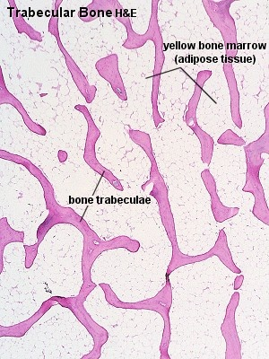
SPONGY BONE
Composed of bone spicules - Trabeculae
Varying shapes and sizes – Honeycomb pattern
Large spaces between trabeculae are filled with marrow.
The composition of (cells and matrix) is the same as that of compact bone.
Difference : The lamellae are not arranged concentrically around a central canal, but run parallel to one another.

Slide 15
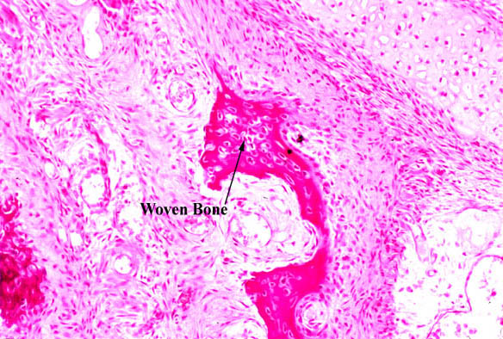
Woven Bone
First formed bone
Immature
Non-lamellar form of bone
Woven bone is weak
Randomly (Irregular) oriented collagen fibers,
Usually not seen after birth. (Only formed during periods of repair/fracture or growth)

Slide 16
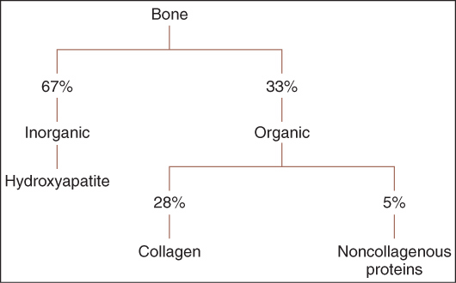
Composition
BONE
INORGANIC
(67%)
Ca, Ph, Mg, Na, Fe, Zn, Cu
ORGANIC
(33%)
Cells, Fibres, Ground substances
HYDROXYAPATITE
Ca and P
Type I COLLAGEN
(28%)
NON COLLAGENOUS
PROTIENS (5%)
Proteoglycan
Glycoprotein
Osteocalcin
Osteopontin
Osteonectin
BSP
Growth factors
BMP
FGF
PDGF

Slide 17
BONE CELLS
Osteoblasts
Osteocytes
Osteoclasts

Slide 18
Osteoblasts
Bone forming cells
(found near area of bone formation)
Mononucleated cell
Cuboidal , basophilic cytoplasm, prominent round nucleus
Extensive ER, Golgi, numerous mitochondria & vesicles
Cellular layer covering the bone surface
High level of alkaline phosphate
(which initiates bone minerlization & the growth of hydroxy apatite)

Slide 19
Osteocytes
Osteoblasts which get entrapped in the osteoid tissue during bone formation
Reduce in size & lie in a space called osteocytic lacunae
Numerous canaliculi are radiating from lacunae, anastomose & establish the contact with the blood vessels.
Canaliculi function : permit diffusion of nutrients, gases & waste products. Also act as signalling mediators
In ground section osteocytes are lost & lacunae appear black in transmitted light

Slide 20
OSTEOCLAST
Large multinucleated cells (40 – 100 μm)
Dozon or more nuclei (12-20)
Occurs in clusters
Prominent mitochondria, lysosomes & few endoplasmic reticulum
Found in bay like depression (Howship's lacunae)
Rich in acid phosphatase & Cathepsin containing vacuoles
Function : resorbtion (breakdown) of bone

Slide 21
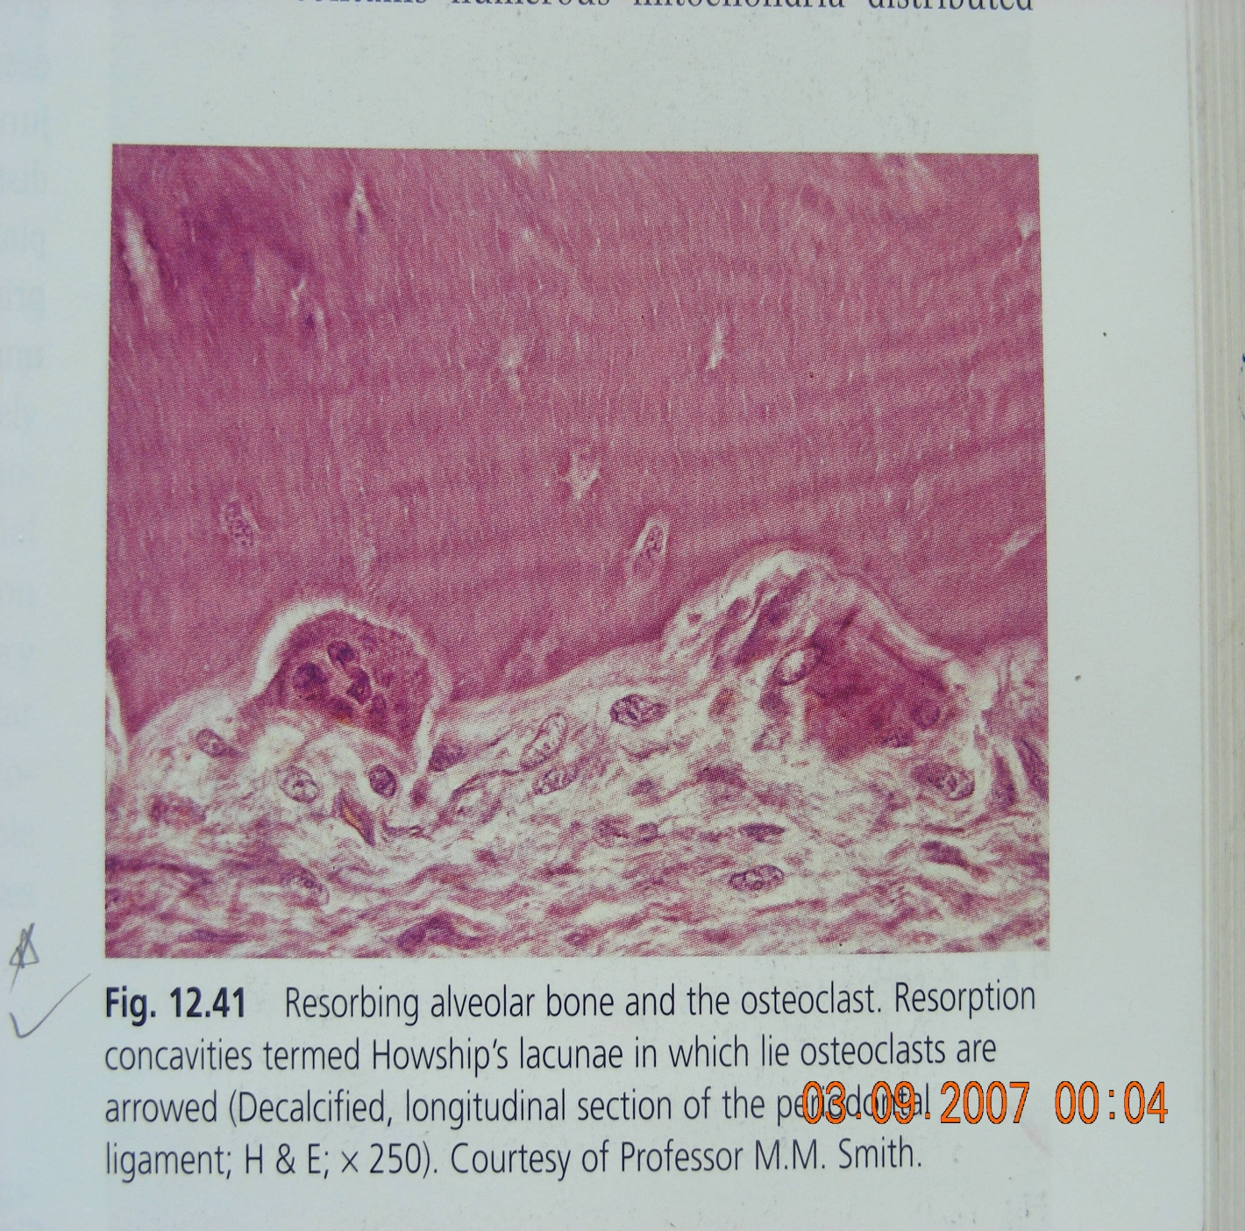
Osteoclasts Osteocytes

Slide 22
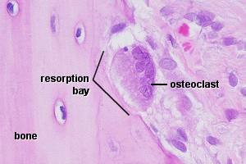
Osteoblasts | Osteocytes | Osteoclast
Secrete matrix of bone (collagen fibres and ground substance ) Responsible for the calcification of the matrix | Osteoblast completely surrounded by matrix, it is called an osteocyte. Responsible for maintaining the matrix (can both secrete and resorb matrix.) | Large, multinucleated cells arise from monocytes. Responsible for the resorption of bone. (break down bone matrix)

Slide 23
“ Bone Remodelling ”
Complex process that involves bone resorption (performed by osteoclasts) followed by bone formation (by osteoblasts)
Bone resorption
+
Bone deposition
Bone Remodelling

Slide 24
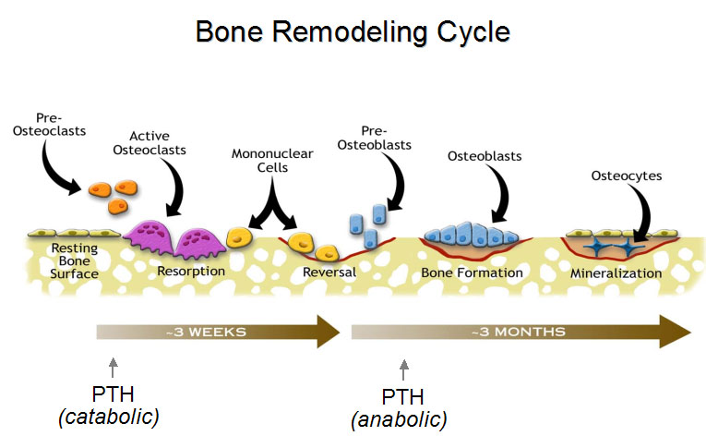

Slide 25
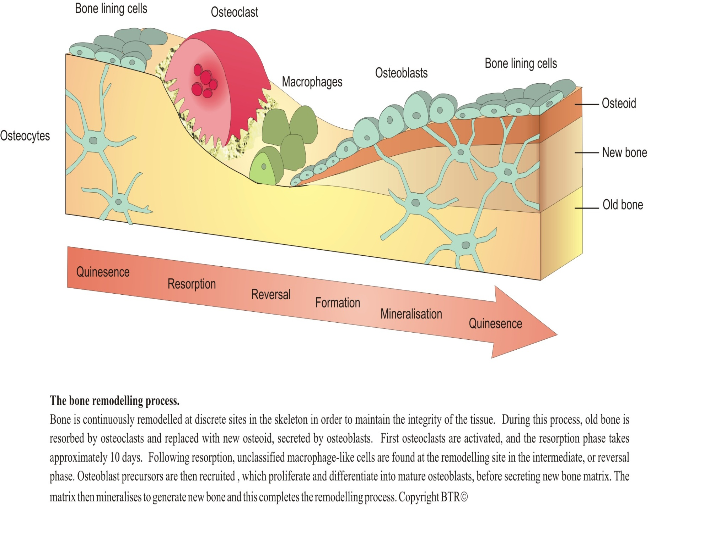

Slide 26

Jaw bones
Basal bone
Cortical plates
(buccal+lingual)
Spongy bone
(cancellous )

Slide 27
Compact bone Spongy bone
Dense bone / Cortical bone/ Lamellar bone
Consist of osteons (Haversian system)
Tightly packed solid mass
Arranged in layers (Lamellae)
Present in periphery as hard outer layer
Responsible for stability of skeleton
Cancellous bone / Trabecular bone / Medullary bone
Composed of bone spicules – Trabeculae
Loosely packed in Honeycomb pattern
Varying shapes and sizes of trabeculae
Found in center enclosing bone marrow cavity.
Accounts for elasticity

Slide 28
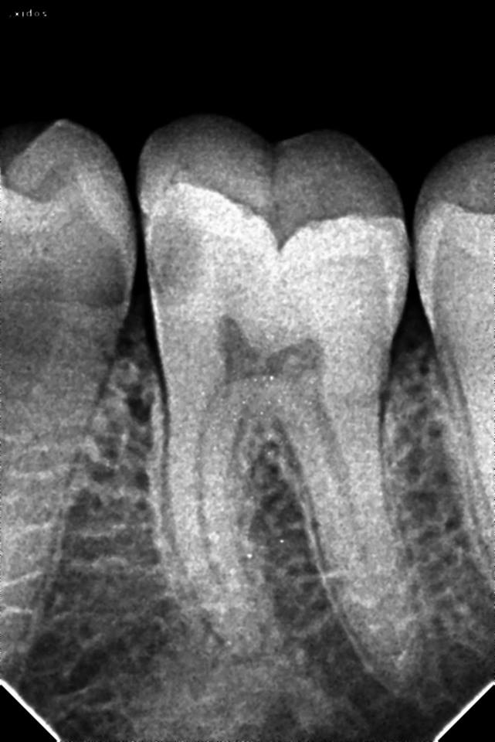
Spongy bone
(cancellous )

Slide 29
Alveolar Process
Alveolar Process is that part of the jaw which supports & attaches the teeth. It consists of two parts
Alveolar bone proper-
Forms socket wall & give attatchments to PDL
2) Supporting bone –
consists B-L plates &
spongy(cancellous ) bone in between.
Alveolar process depends upon presence of teeth & resorbed after teeth lost
Presence of basal bone is dependent of the teeth

Slide 30
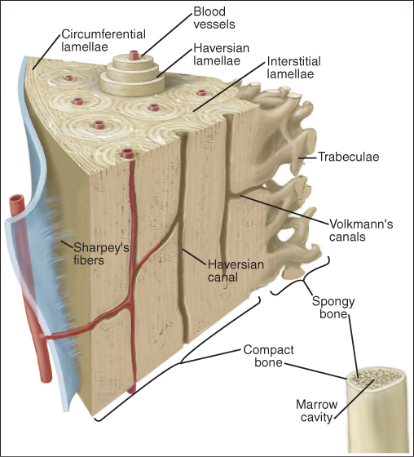
ALVEOLAR BONE PROPER – (describe about compact/lamellar bone)

Slide 31
Parts of Alveolar bone
Interradicular septum – bone present between the roots in multirooted teeth
Cortical plates – present as buccal & lingual plates of cortical bone surrounding the roots
Interdental septum - bone present between the adjacent teeth
Alveolar bone proper – bone which forms the base of socket

Slide 33
Cribriform plate
Seen in alveolar bone proper
Perforations in the inner wall of socket
These perforations / openings provides passage to carry various branches of blood vessels & nerves into PDL

Slide 34
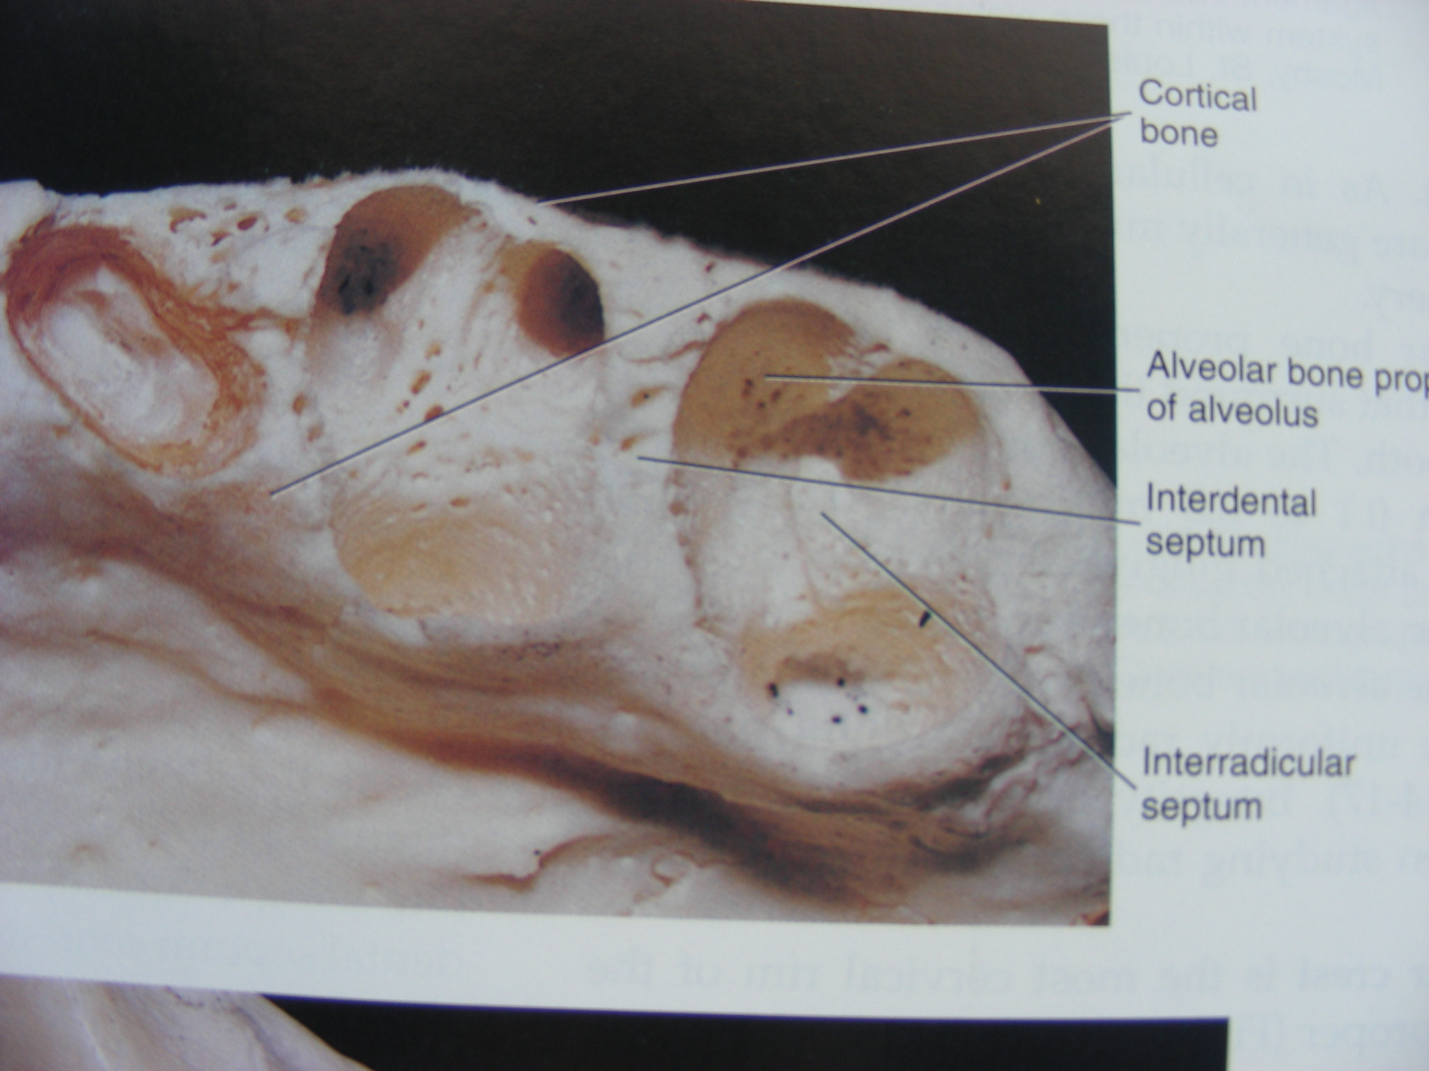
Cribriform plate

Slide 35
Bundle bone
Bone in which principal fibres of PDL are anchored
Why called as “Bundle” ?? =
huge bundle of PDL fibres insert into bone, termed as as Sharpey’s fibres
Contain less fibrils
Consists of compact / lamellar bone
Appears dark in H&E

Slide 36
Functions of alveolar bone
Houses roots of teeth
Anchors roots of teeth to bone via PDL
Movement of teeth (to achieve balanced occlusion)
Shock absorber
Distribution of occlusal forces on teeth
Nutrition to PDL
Organizes eruption

Slide 37
Summary
The alveolar bone is that part of the mandibular and maxillary bone which surrounds the teeth and forms the tooth sockets. The formation of alveolar bone proper is initiated with the eruption of the developing tooth. The bone of the tooth socket is a dense cortical plate into which the principal fibers of the periodontal ligament are inserted, referred to as Sharpey's fibers.
The bone lining the socket is closely contoured with the tooth, and its coronal margin becomes the alveolar crest. The composition of alveolar bone proper is similar to that of other bone. There is some evidence, however, that the alveolar crest is more mineralized than the bone adjacent to the apex of the tooth.

Slide 38
Take home message
Alveolar bone is the part of maxilla and mandible that forms and supports the tooth sockets.
It houses the roots of the teeth
It disappears with loss of tooth

Slide 39
References
SN Bhaskar . Orban’s ,Oral Histology and embryology. 11th edition, Mosby 1998
Neville BW ,Damm DD ,Allen CM ,Bouquot JE . Oral and maxillofacial pathology , 2nd Edition .Philadelphia W.B. Saunders ;2002
Richard Tencate , Oral Histology development ,structure and function . 5th Edition ,1998
Carranza F.A., Michael G. Newman . Clinical periodontology 8,9,10th edition

Slide 40
FAQs
Define & classify bone. Write about alveolar bone in detail including structure & histology.
Difference between compact & spongy bone
Bone cells (osteoblast/osteocyte/osteoclast)
Bundle bone & lamina dura
Remodelling of bone
Cribriform plate & nutrient canals of Zuckerkandl and Hirschfeld

Slide 41
THANKYOU

